Slide 1


HIT391 MACHINE LEARNING: ADVANCEMENTS AND APPLICATIONS
Lecturer:
Dr. Yan Zhang (Danana)
Dr. Al-Amoodi, Abdullah (Sydney)
Email:
yan.zhang@cdu.edu.au
abdullah.al-amoodi@cdu.edu.au

Slide 2
Week 1: Introduction to Machine Learning
The Contents are heavily inspired by Sebastian Raschka’s course on ML
Learning Outcomes
Introduction of Artificial Intelligence
Introduction of Machine Learning
Examples of Machine Learning
Types of Machine Learning
Resources

Slide 3
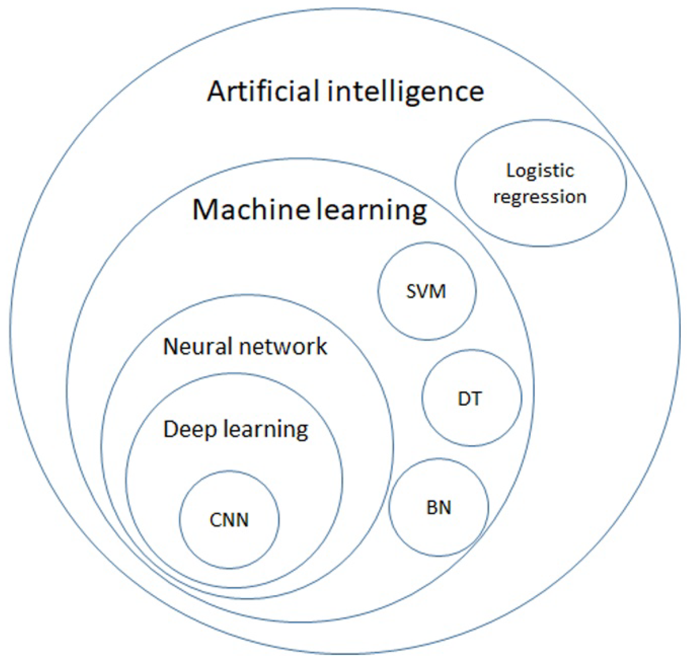
Defining Machine Learning (ML) and Artificial Intelligence (AI)
Traditional
Nowadays
AI
ML
@medium

Slide 4
What is AI?
Artificial intelligence is the ability of a computer or robot controlled by a computer to perform tasks normally performed by humans because they require human intelligence and discernment.

Slide 5
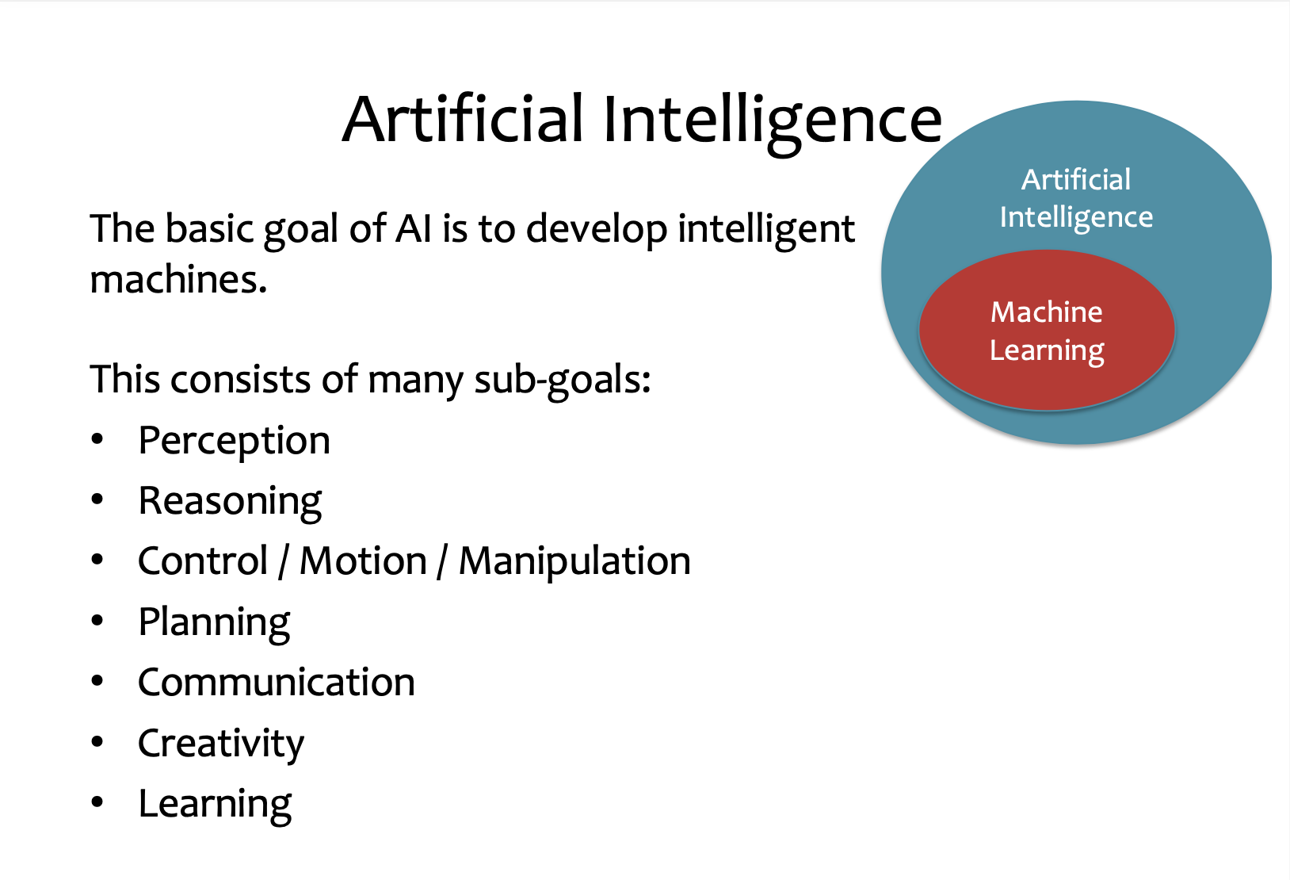

@CMU

Slide 6
Big Data
Widespread use of personal computers and wireless communication leads to “big data”
We are both producers and consumers of data
Data is not random, it has structure, e.g., customer behavior
We need “big theory” to extract that structure from data for
(a) Understanding the process
(b) Making predictions for the future

Slide 7
Why “Learn” ?
Machine learning is programming computers to optimize a performance criterion using example data or past experience.
Learning is used when:
Human expertise does not exist (navigating on Mars),
Humans are unable to explain their expertise (speech recognition)
Solution changes in time (routing on a computer network)
Solution needs to be adapted to particular cases (user biometrics)

Slide 8
When We Talk About “Learning”
Learning general models from a data of particular examples
Data is cheap and abundant (data warehouses, data marts); knowledge is expensive and scarce.
Example in retail: Customer transactions to consumer behavior:
People who bought “computer” also bought “keyboard” (www.amazon.com)
Build a model that is a good and useful approximation to the data, and learn the model from given data.

Slide 9
What is Machine Learning?
Machine Learning is a sort of artificial intelligence that enables software applications to grow increasingly accurate at predicting events without explicitly programming them to do so.

Slide 10
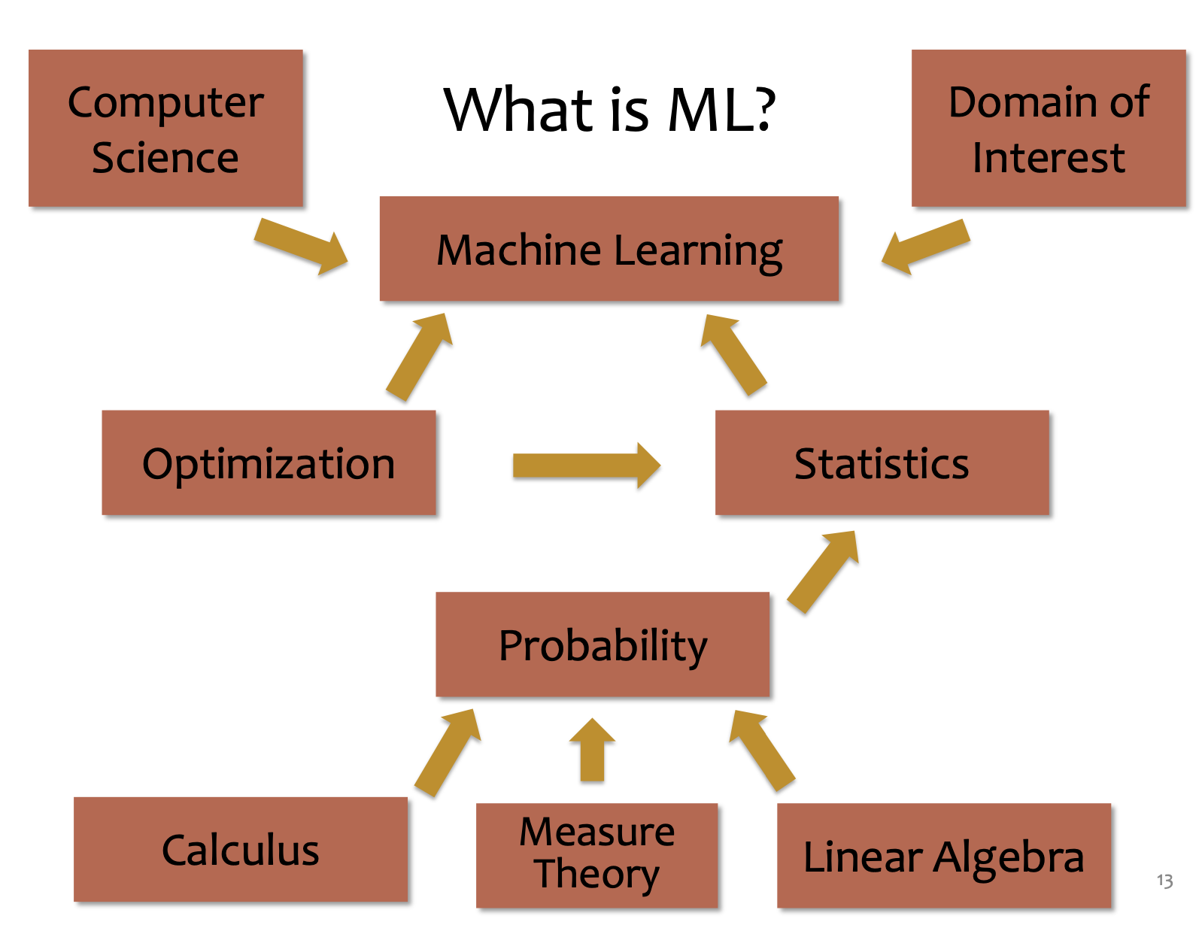
@CMU

Slide 11
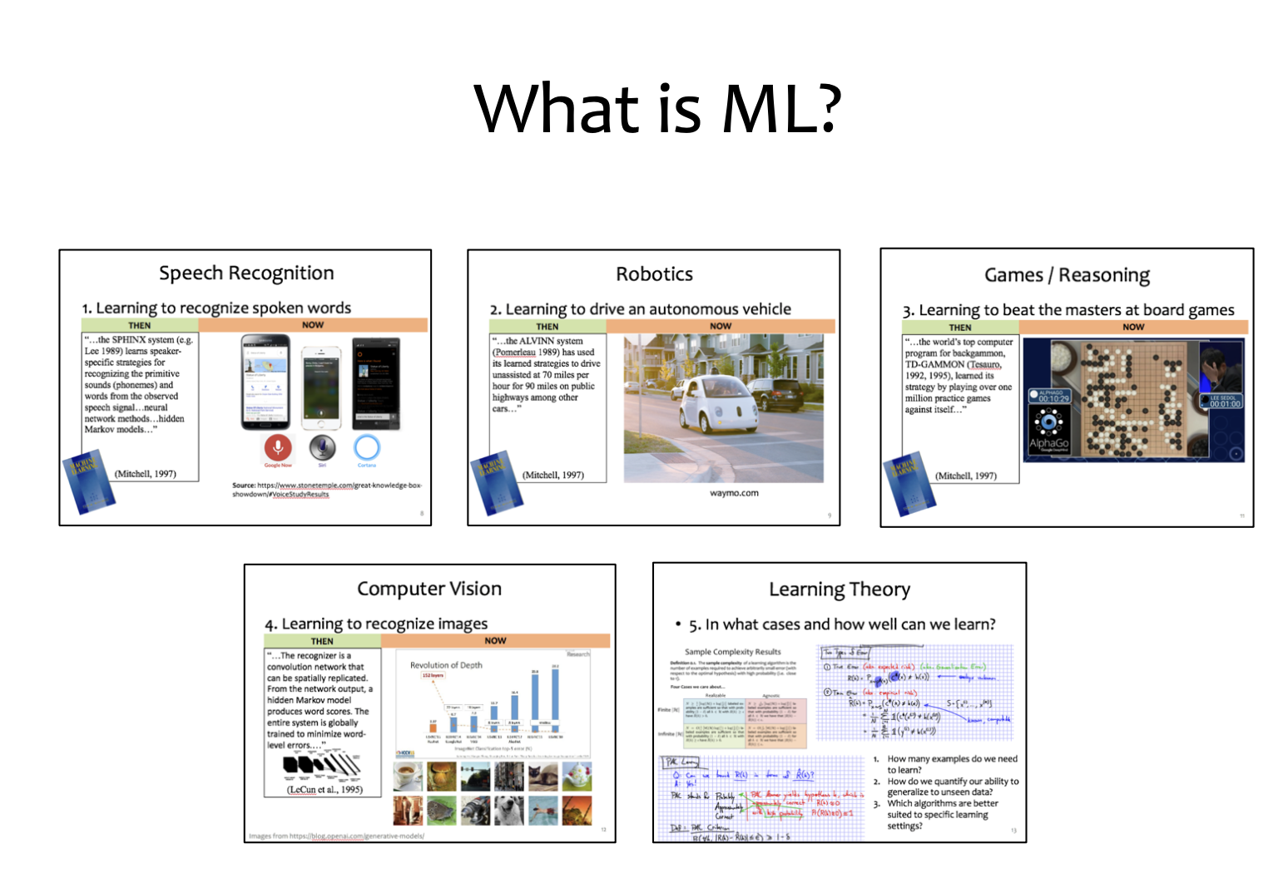
@CMU

Slide 12
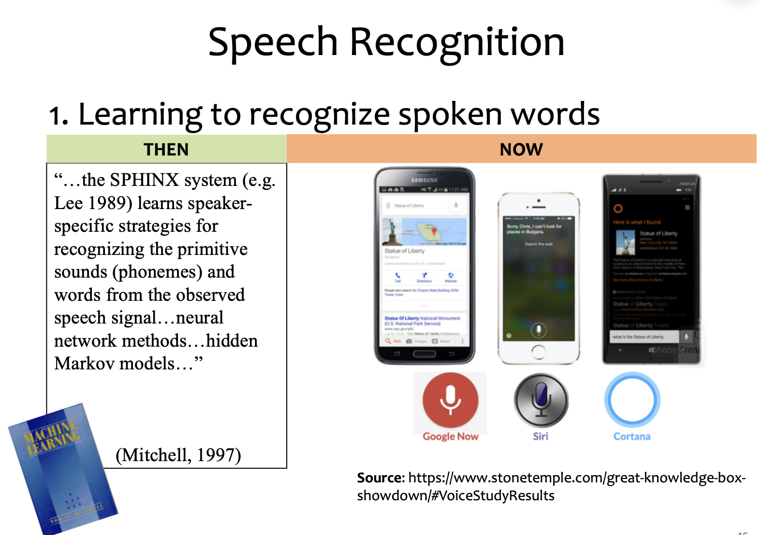
@CMU

Slide 13
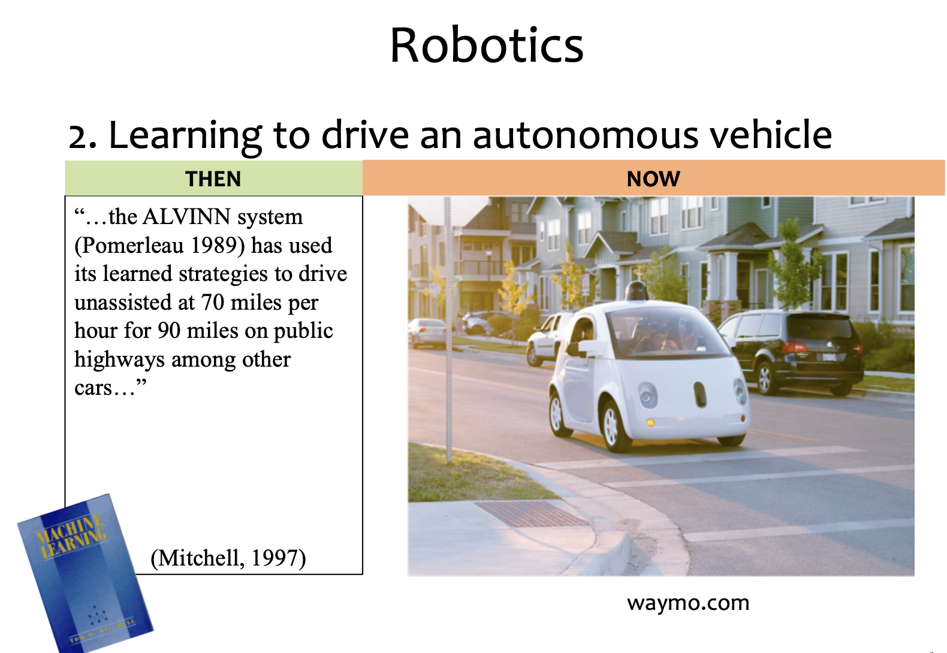
@CMU

Slide 14
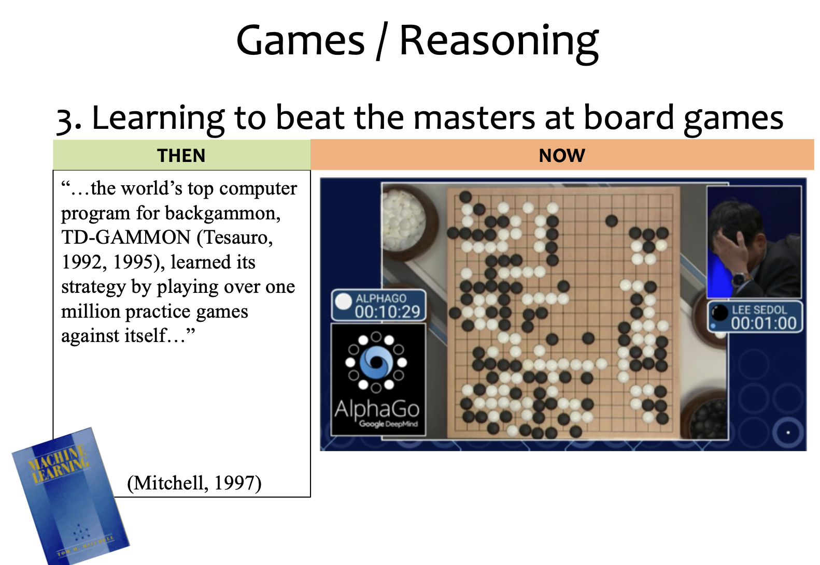
@CMU

Slide 15
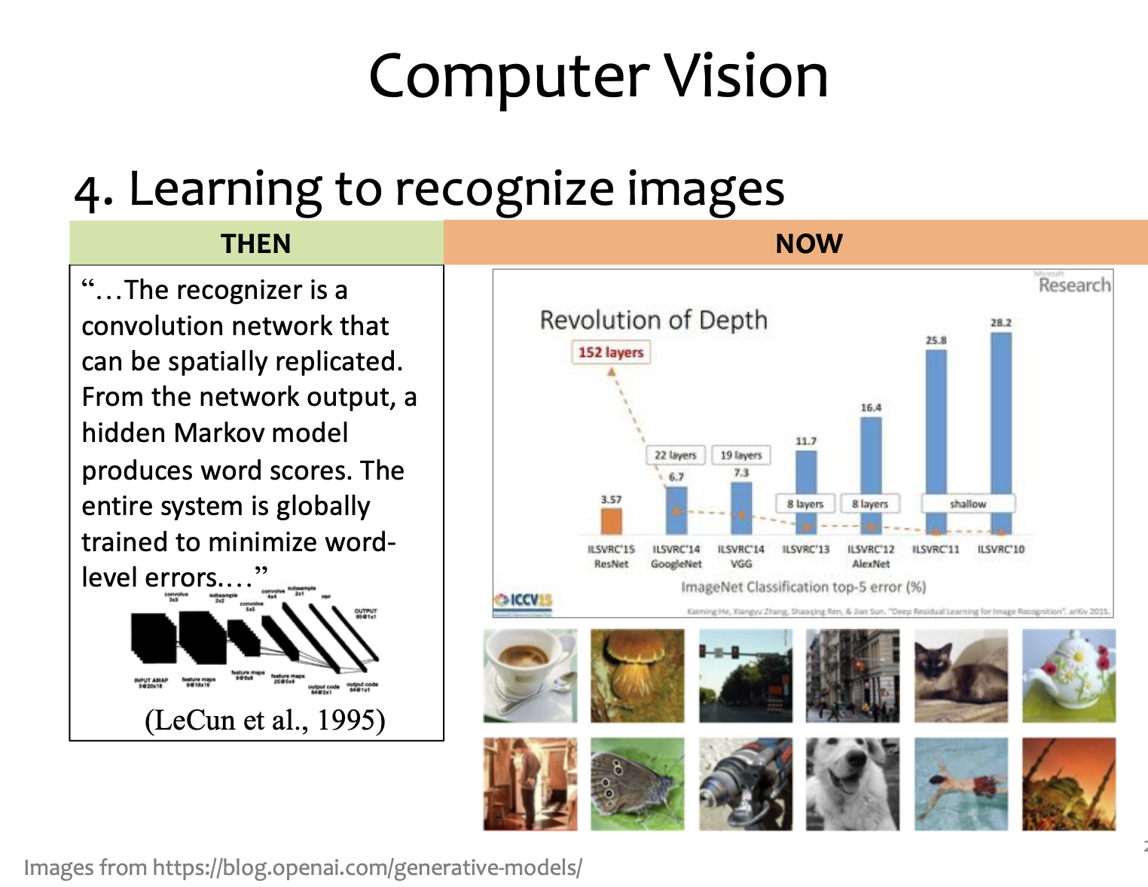
@CMU

Slide 16
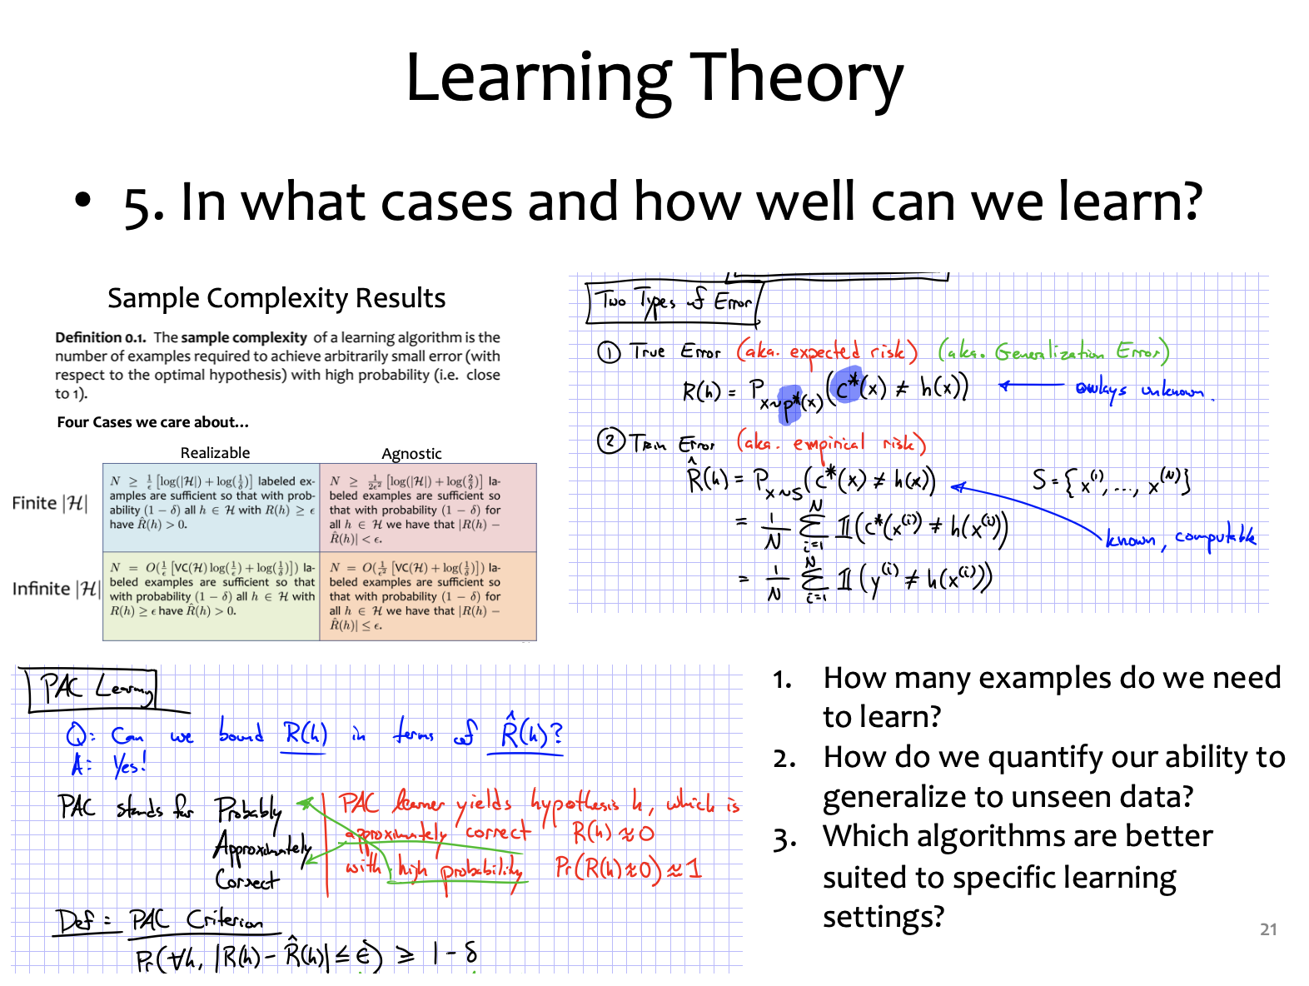
@CMU

Slide 17
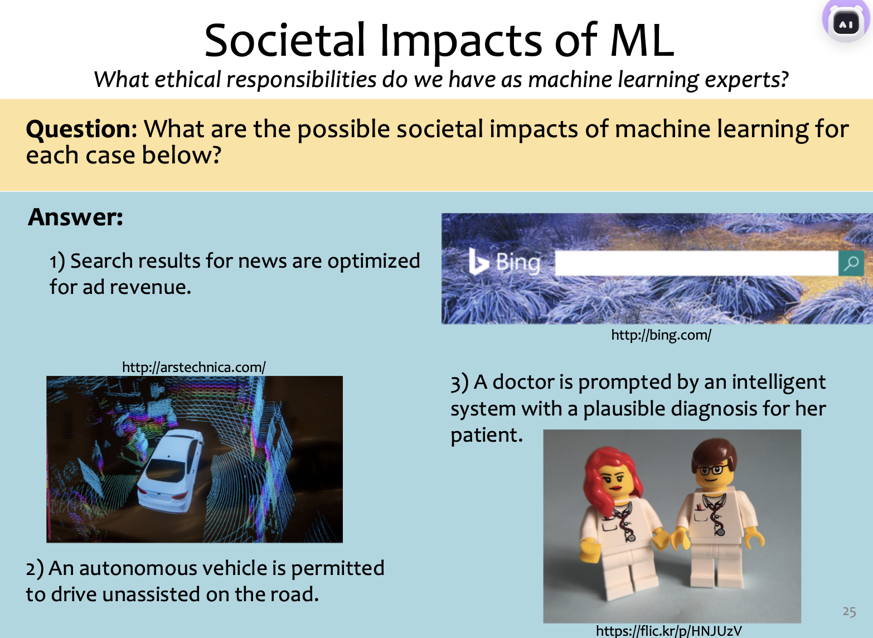
@CMU

Slide 18
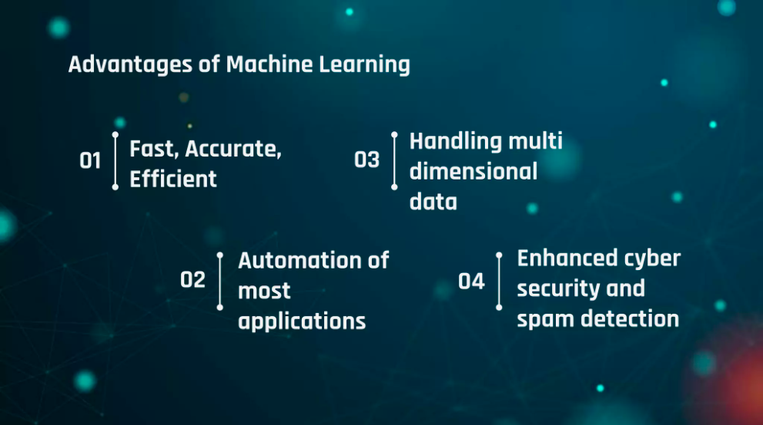

Slide 19
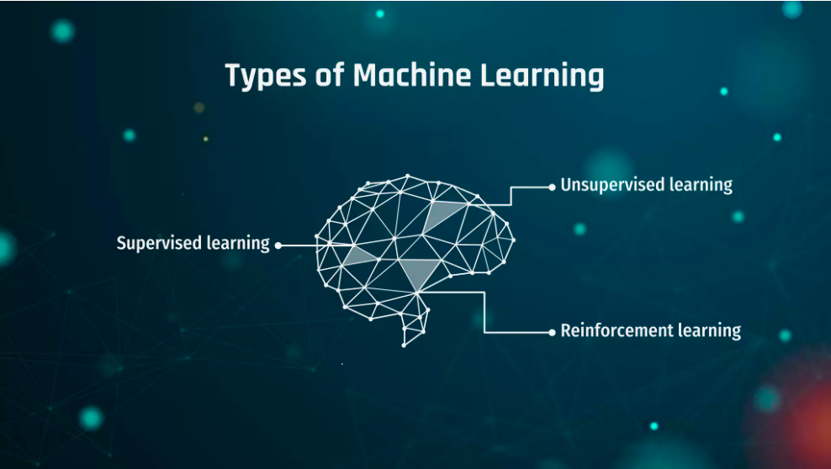

Slide 20
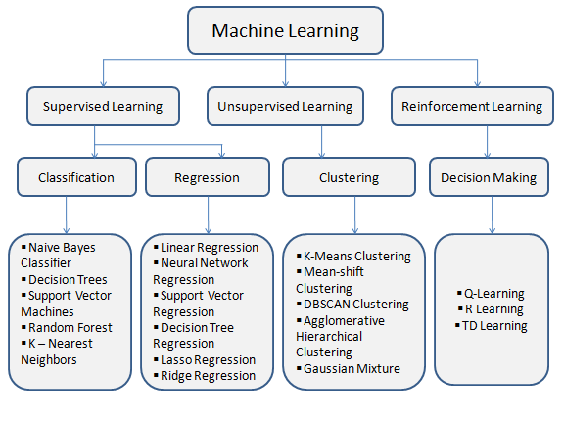
@Cancer (MDPI)

Slide 21
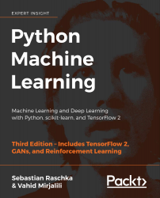
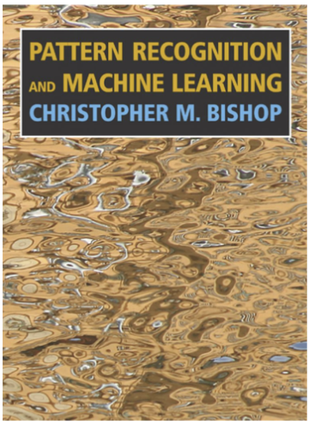
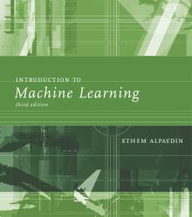
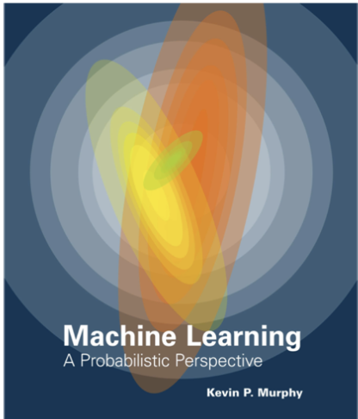
Textbooks
You are not required to read a textbook, but it will help immensely!

Slide 22
Resources: Datasets
UCI Repository: http://www.ics.uci.edu/~mlearn/MLRepository.html
Statlib: http://lib.stat.cmu.edu/

Slide 23
Resources: Journals
Journal of Machine Learning Research www.jmlr.org
Machine Learning
Neural Computation
Neural Networks
IEEE Trans on Neural Networks and Learning Systems
IEEE Trans on Pattern Analysis and Machine Intelligence
Journals on Statistics/Data Mining/Signal Processing/Natural Language Processing/Bioinformatics/...

Slide 24
Resources: Conferences
International Conference on Machine Learning (ICML)
European Conference on Machine Learning (ECML)
Neural Information Processing Systems (NIPS)
Uncertainty in Artificial Intelligence (UAI)
Computational Learning Theory (COLT)
International Conference on Artificial Neural Networks (ICANN)
International Conference on AI & Statistics (AISTATS)
International Conference on Pattern Recognition (ICPR)
...

Slide 25

References
https://www.slideshare.net/EvgeniyMarinov/pipeline-of-supervised-learning-algorithms
https://www.slideshare.net/PravinkumarLandge/unsupervised-learning-clustering-238979833
https://www.slideshare.net/cprakash2011/reinforcement-learning-40052403

